Slide 1

GuideSense
Your Trusted Navigation Companion
Team: Power Angers
Sprint 0

Slide 2
Agenda
1
2
3
Team Member
Team Member Name
Role & Responsibilities
Project Overview
Project Statement
Project Description
Personas
Technologies & Tools
Platforms
Algorithms
4
Team Logistics
Project Schedule
Team Working Agreement
5
Retrospective
Feedbacks
Improvements

Slide 3
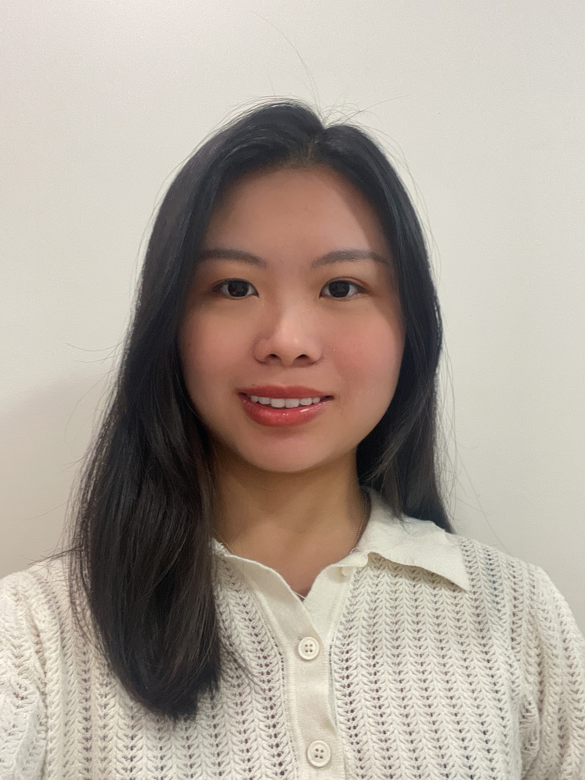
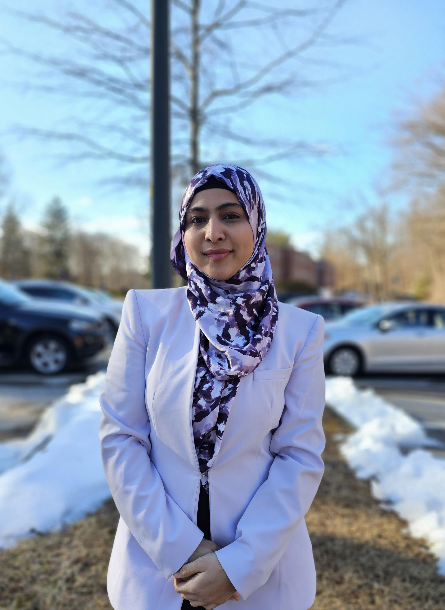
Power Anger
Afziya Waknis
Kaiyin Chen
Project Manager
Aw14091n@pace.edu
Database Administrator
Kaiyin.chen@pace.edu

Slide 4

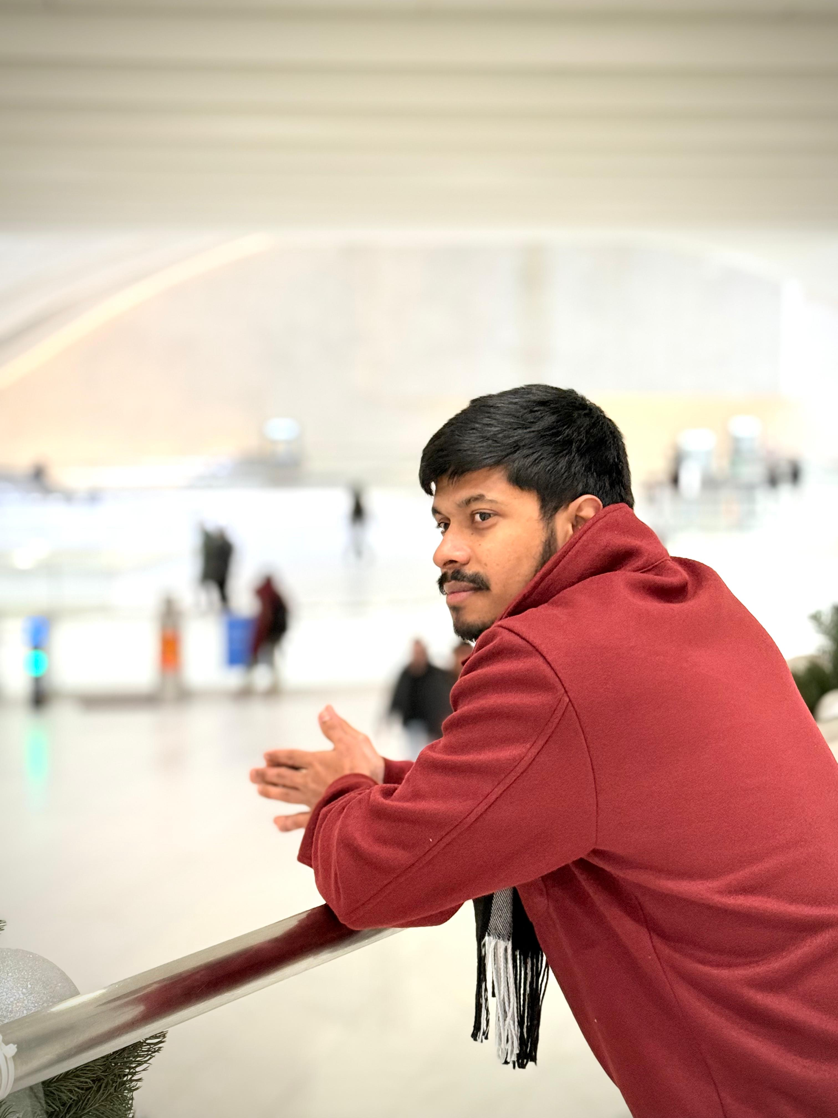
Power Anger
Ritesh Singh
Dinesh Gopi Sunkara
DevOps
Ritesh.singh@pace.edu
Scrum Master
Ds46669n@pace.edu

Slide 5
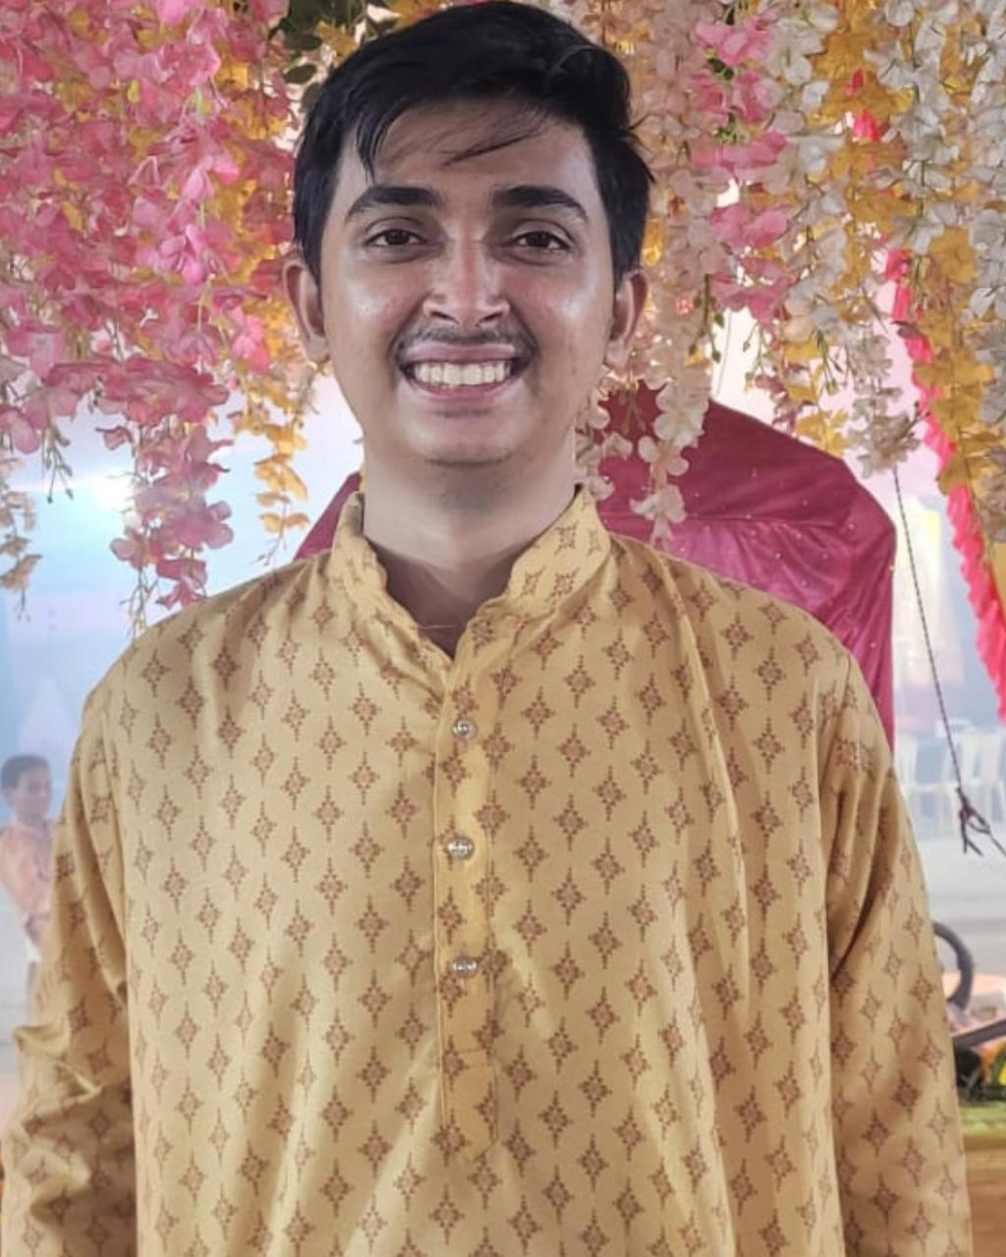
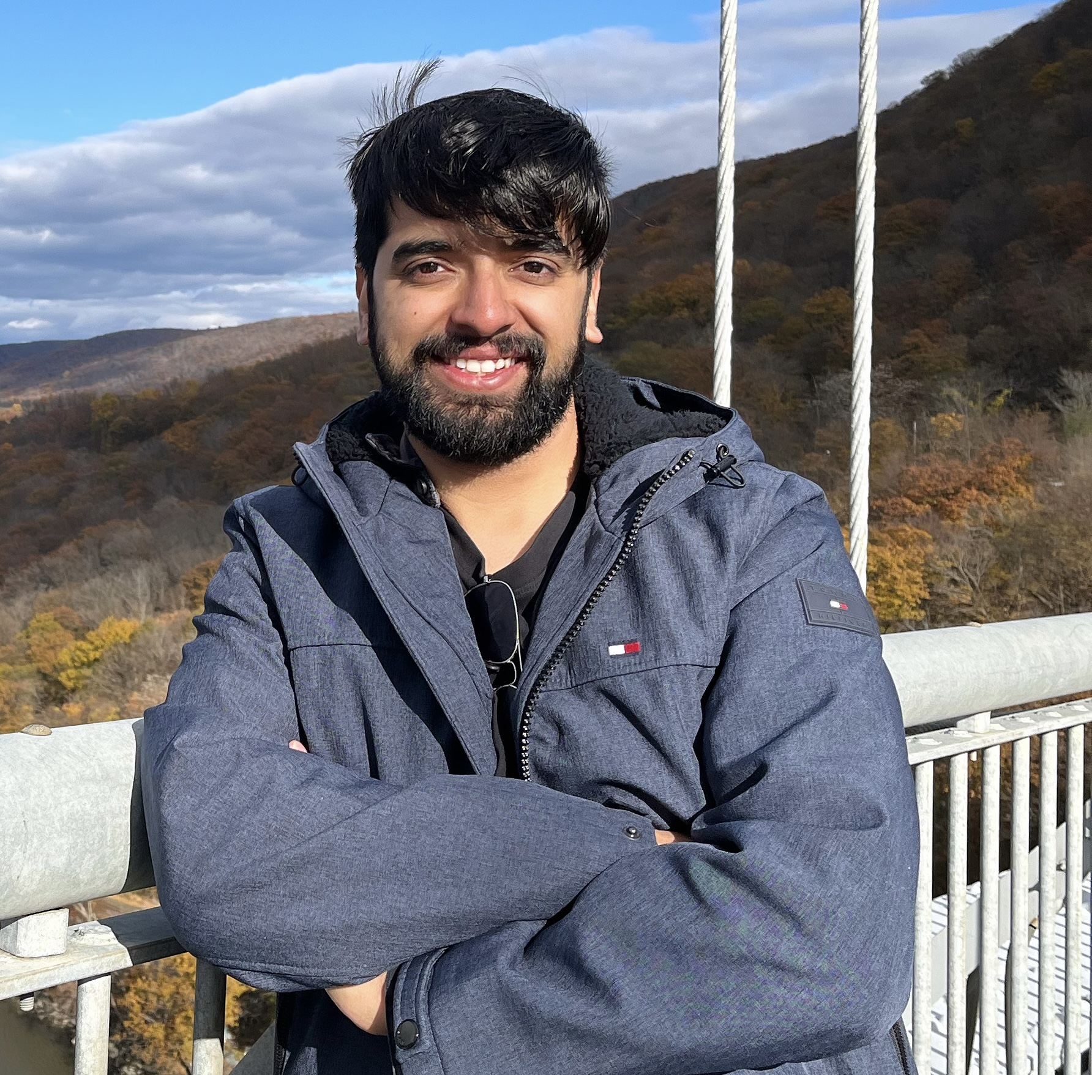
Power Anger
Rushabh Makwana
Vaibhav Thapliyal
Developer Lead
Frontend Developer
Vaibhav.thapliyal6@gmail.com
Backend Developer
Rm36294n@pace.edu

Slide 6
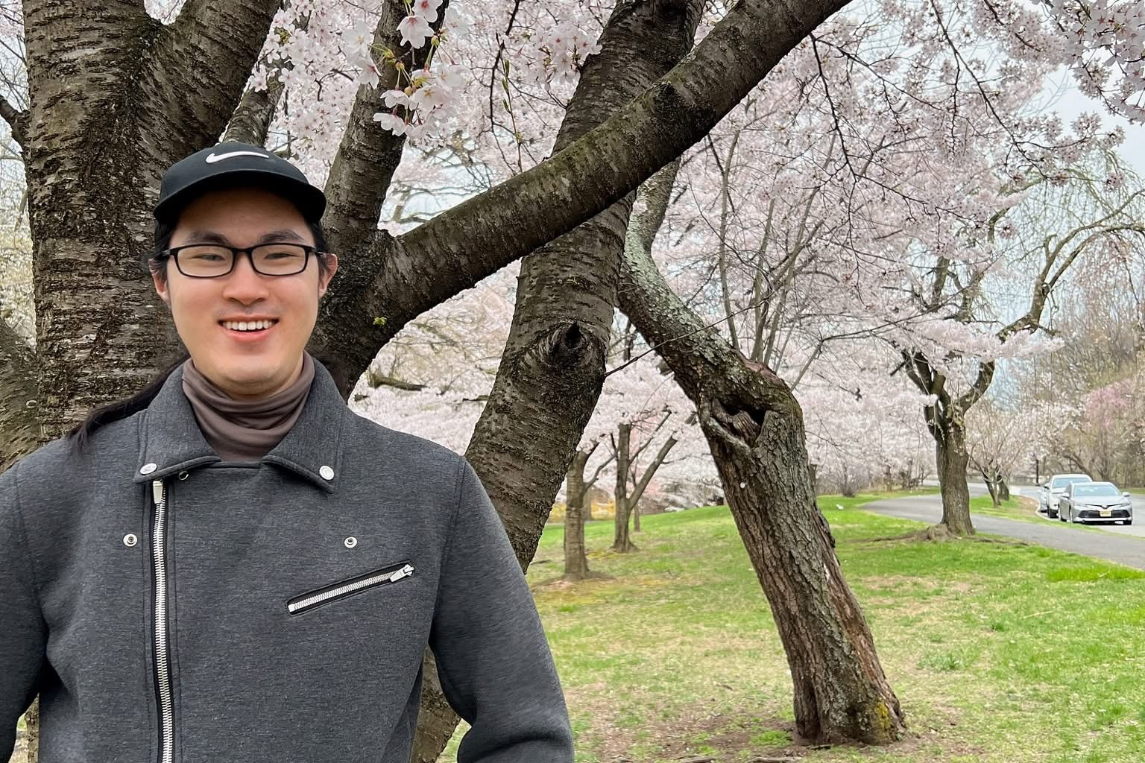
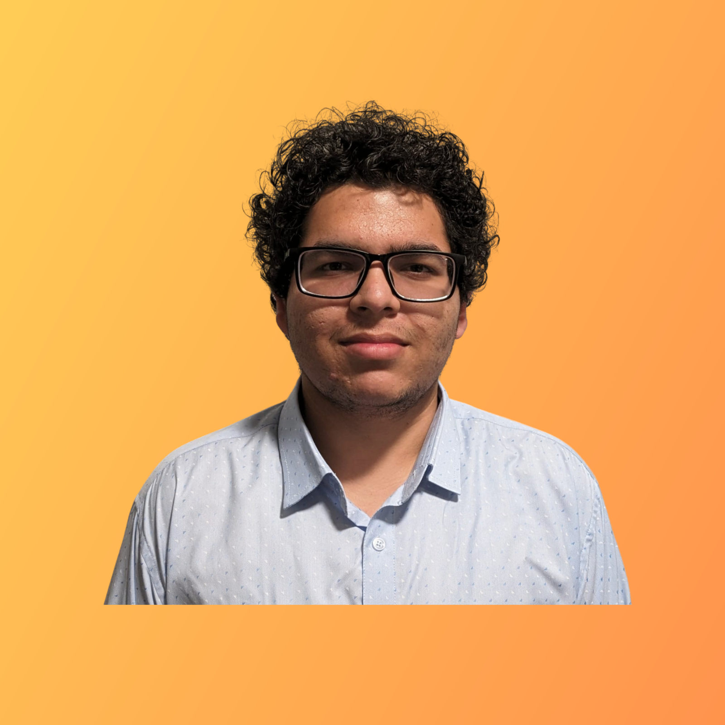
Power Anger
Min Jung
Hrishikesh Shah
Quality Analyst
Mj34564n@pace.edu
Frontend Developer
Hs75142n@pace.edu

Slide 7
Problem Statement
Navigating through everyday environments presents significant challenges for blind and visually impaired individuals., moving vehicles, and the lack of real-time guidance.
Traditional mobility aids like canes and guide dogs, while helpful, often fall short in providing comprehensive and real-time information about obstacles, directions, and surroundings.
This lack of real-time situational awareness can lead to increased risks of accidents and restrict the independence of visually impaired individuals.
Therefore, there is a pressing need for an innovative solution that leverages modern technology to enhance mobility and safety for the visually impaired community.
This project aims to create a web app that uses object detection and voice commands to help blind people navigate safely by warning them about obstacles, giving directions, and describing their surroundings in real time.

Slide 8
Project Description
This innovative web app leverages computer vision and machine learning to provide real-time audio guidance, identifying objects, obstacles, and crosswalks for the blind and visually impaired.
Combining GPS and AI object detection, it aims to make it easier and safer for blind people to get around independently, especially in cities and outdoor areas.
The goal is to provide a helpful, accessible, and dependable way for visually impaired people to navigate.
Key features of the application include:
Real-time Object Detection
Voice Navigation and Alerts
GPS Integration
User-Friendly Interface

Slide 9
Project Schedule
Sprint 0
Sprint 1
Sprint 2
Sprint 3
1/21/2025 - 2/10/2025
2/11/2025 - 3/10/2025
3/11/2025 - 4/7/2025
4/8/2025 - 4/28/2025
Daily Scrum
Retrospective
Daily Scrum
Scrum Planning
Retrospective
Daily Scrum
Scrum Planning
Retrospective
Daily Scrum
Scrum Planning
Retrospective

Slide 10
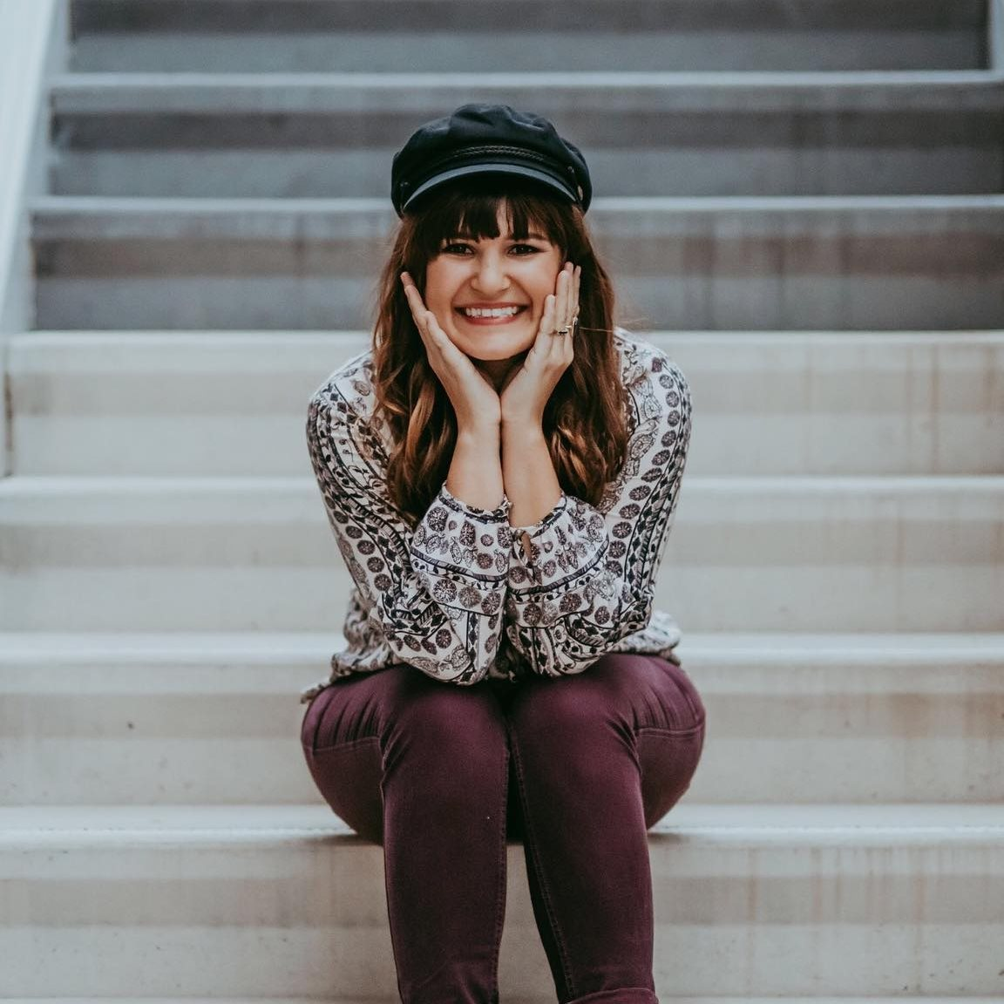
Persona One: The Independent Blind User
Name: Aisha Khan
Age: 32
Occupation: Software Developer (works remotely)
Background: Aisha has been blind since birth. She is highly tech-savvy and relies on assistive technology. She is motivated to use tools that enhance her independence and streamline daily activities.
App Usage Scenario: Aisha wants to use the app for navigation while walking, especially in unfamiliar areas, and identify objects which could be a barrier for seamless tasks.
Needs: Seamless integration with existing assistive technologies (screen readers, voice control), accurate location services, reliable information about accessible routes and environments, and robust privacy features.
Goals: Increased independence, improved access to information, enhanced safety while navigating, and streamlined daily task management.

Slide 11
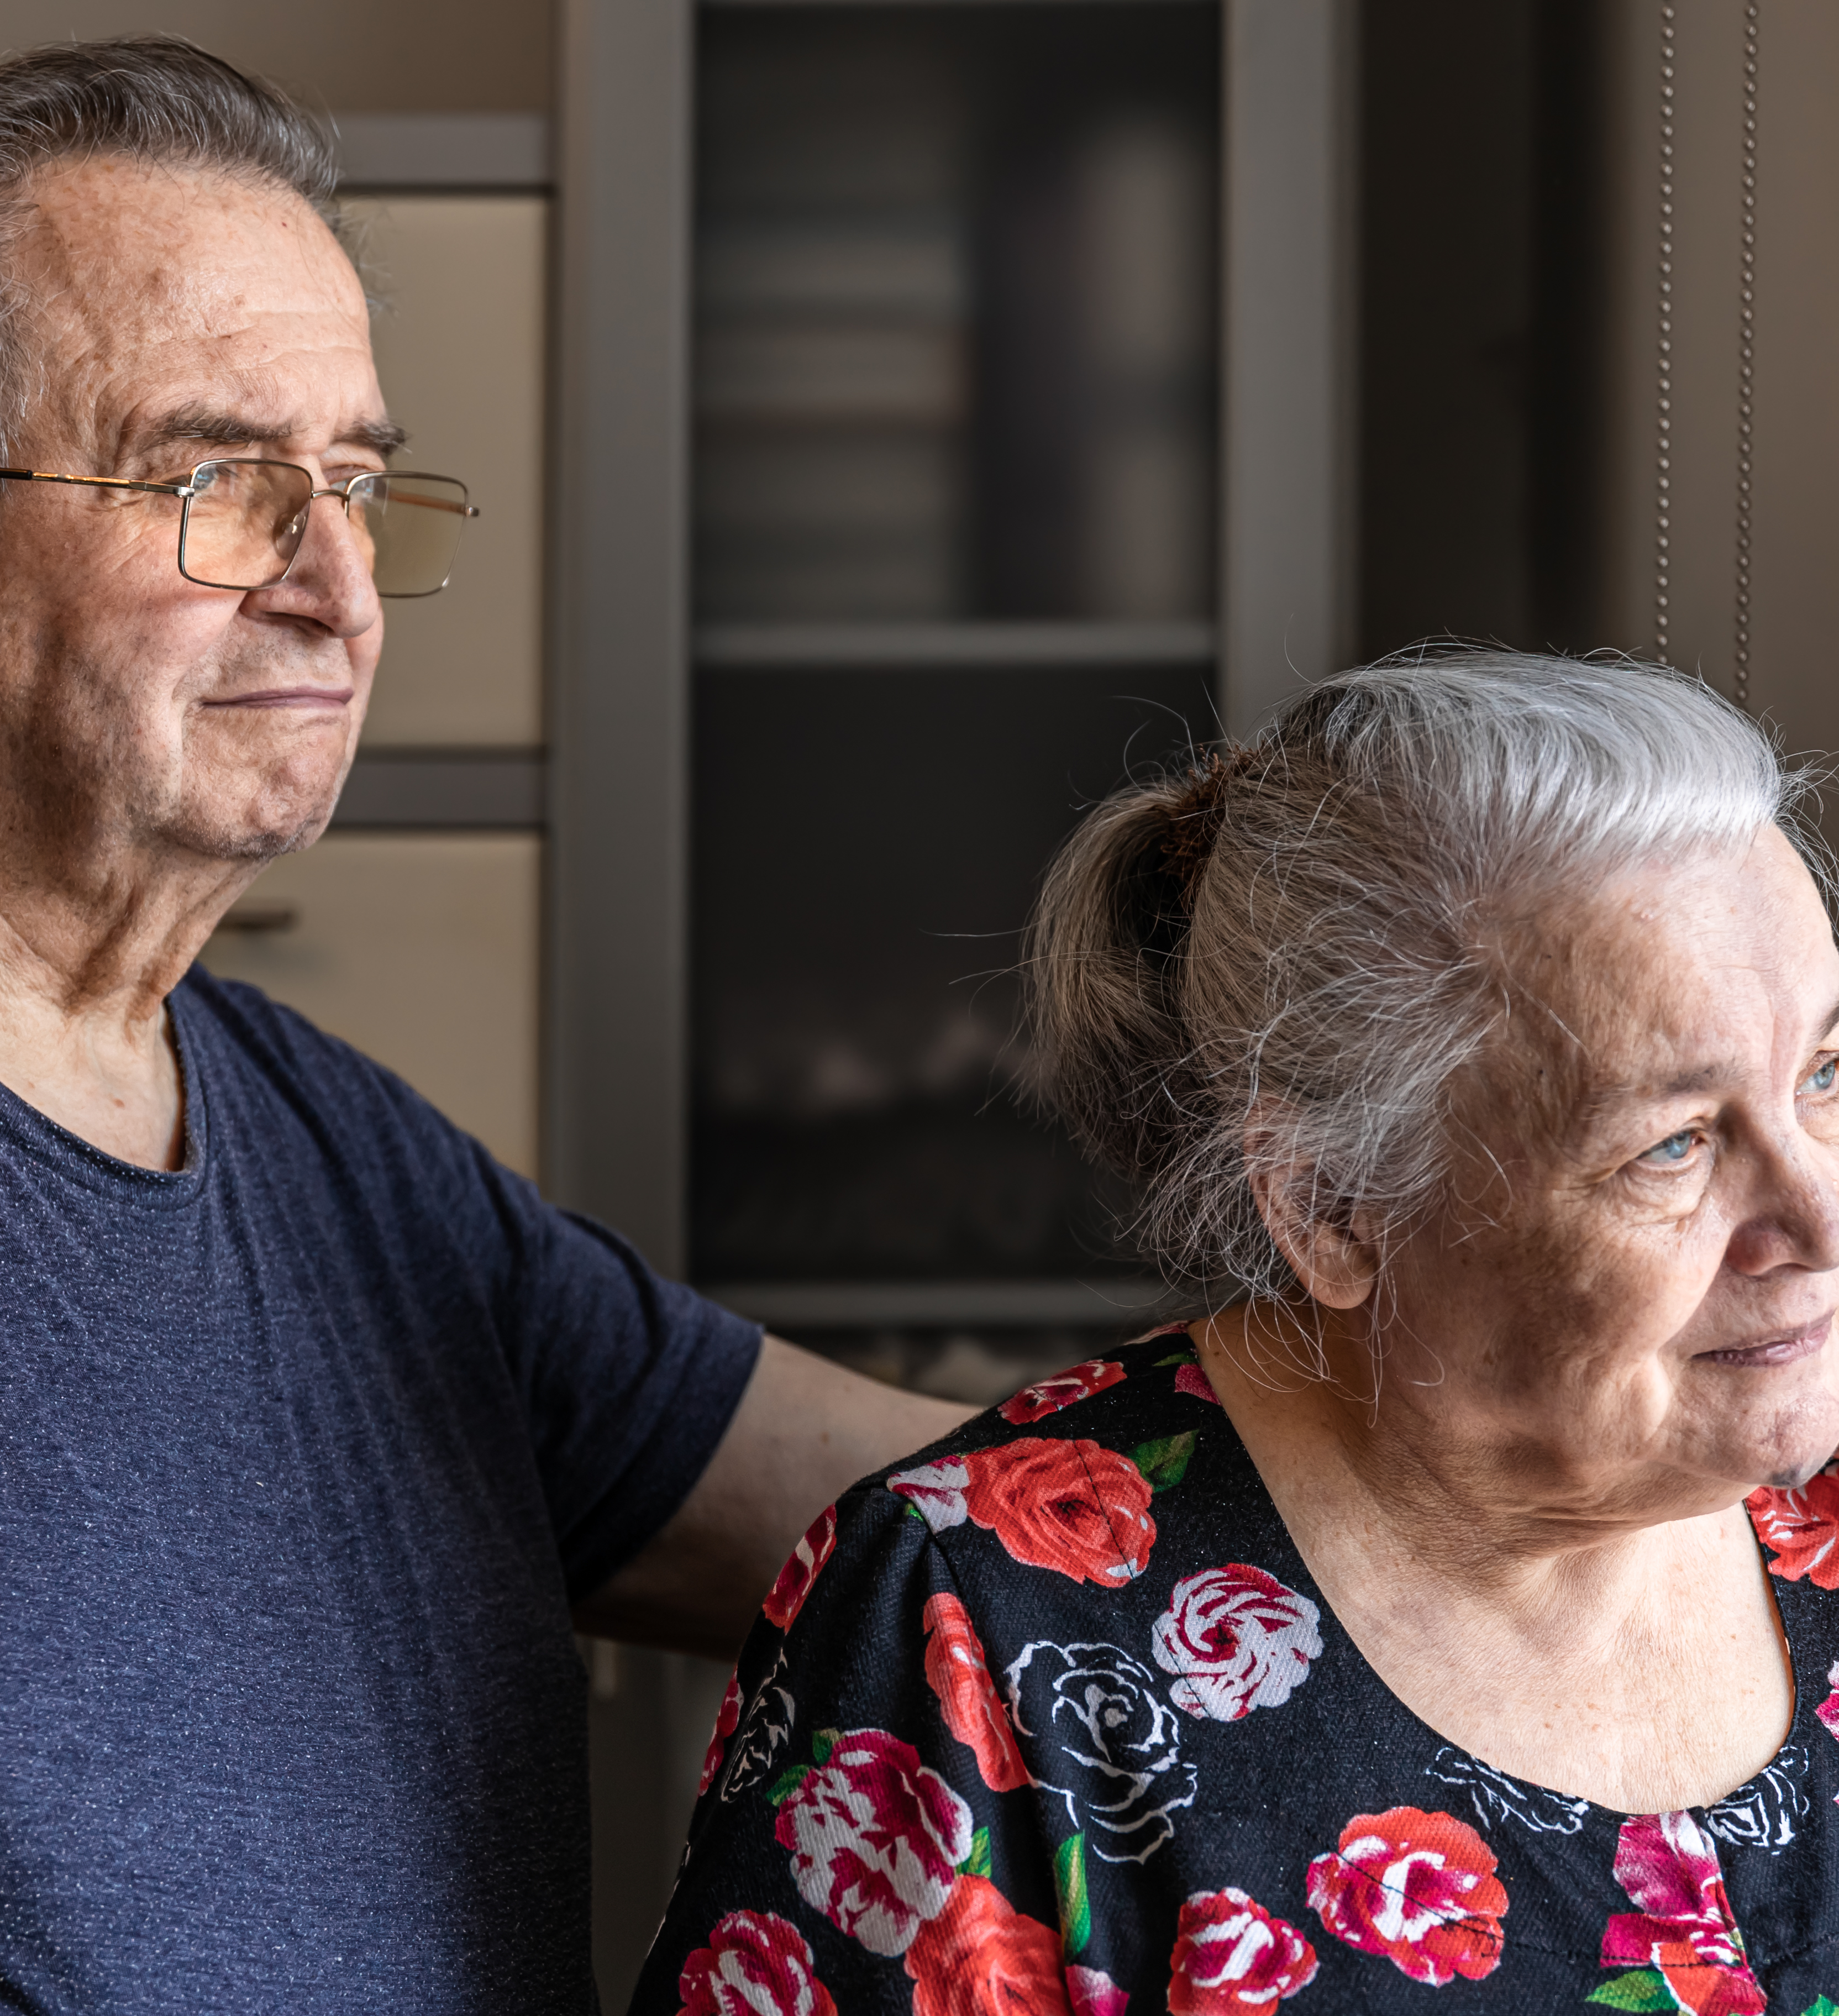
Persona Two: The Concerned Family Member
Name: Robert Chen
Age: 65
Relationship: Son of a visually impaired senior
"I worry about my mother's safety. I hope this app can help me stay connected and ensure she's doing okay."
Background: Robert's mother is losing her vision due to macular degeneration. He lives in a different city and wants to stay connected and provide support remotely.
App Usage Scenario: Robert wants to use the app to track his mother's location (with her consent), receive alerts if she deviates from her usual routes, remotely assist her with tasks like medication reminders, and communicate with her easily through the app's accessible interface.
Needs: User-friendly interface, reliable location tracking (with privacy safeguards), remote assistance features, accessible communication tools, and clear instructions for setup and use.
Goals: Increased peace of mind, improved communication with his mother, ability to provide remote support, and enhanced safety for his visually impaired parent

Slide 12
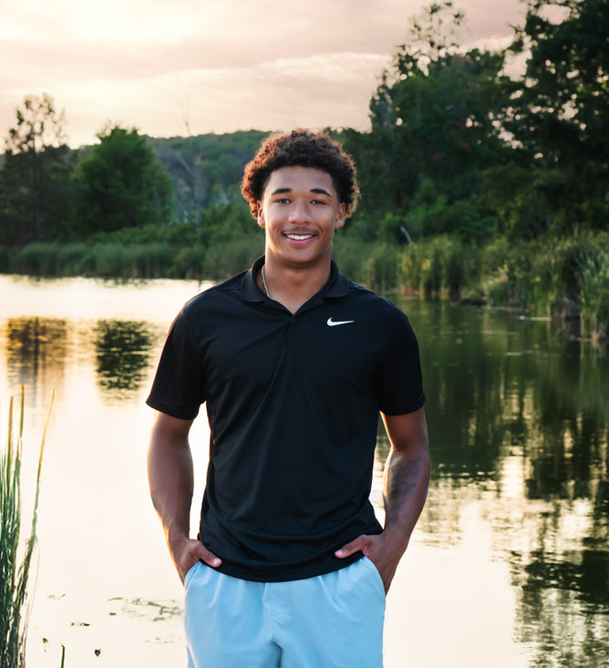
Persona Three : Partially sighted Teenager
Name: David Miller
Age: 16
Background: David has low vision due to a genetic condition. He can see some things with the aid of glasses or magnifiers.
"I want to be able to do the same things my friends do. I hope this app can help me navigate more easily and access information."
App Usage Scenario: David wants to use the app to magnify text and images, identify colors, navigate public transportation, and access audio descriptions of videos and other media. He needs an app that is easily customizable to his specific visual needs.
Needs: Customizable display settings (font size, contrast, color schemes), reliable object and text recognition features, seamless integration with magnification tools, and accessible interface that can be used with limited vision.
Goals: Increased independence, improved access to information, enhanced social participation, and greater confidence in navigating the world.

Slide 13









Technologies & Tools
Programming Language
Database
Tools

Slide 14
AI Model
YOLO, which stands for ‘You Only Look Once,’ is a state-of-the-art object detection model known for its real-time speed and accuracy.
Real-time Speed: Processes the entire image in a single pass, making it one of the fastest models for object detection.
Grid-Based Detection: Divides the image into a grid, with each cell responsible for detecting objects within it.
Accurate Bounding Boxes: Predicts precise bounding boxes and confidence scores for each detected object.
Pre-trained on COCO: Leverages the massive COCO dataset (80 object categories, 200,000+ images) for robust and accurate general object detection
Refined Results: Uses Non-Maximum Suppression (NMS) to eliminate overlapping detections and ensure only the most accurate results are shown.

Slide 15
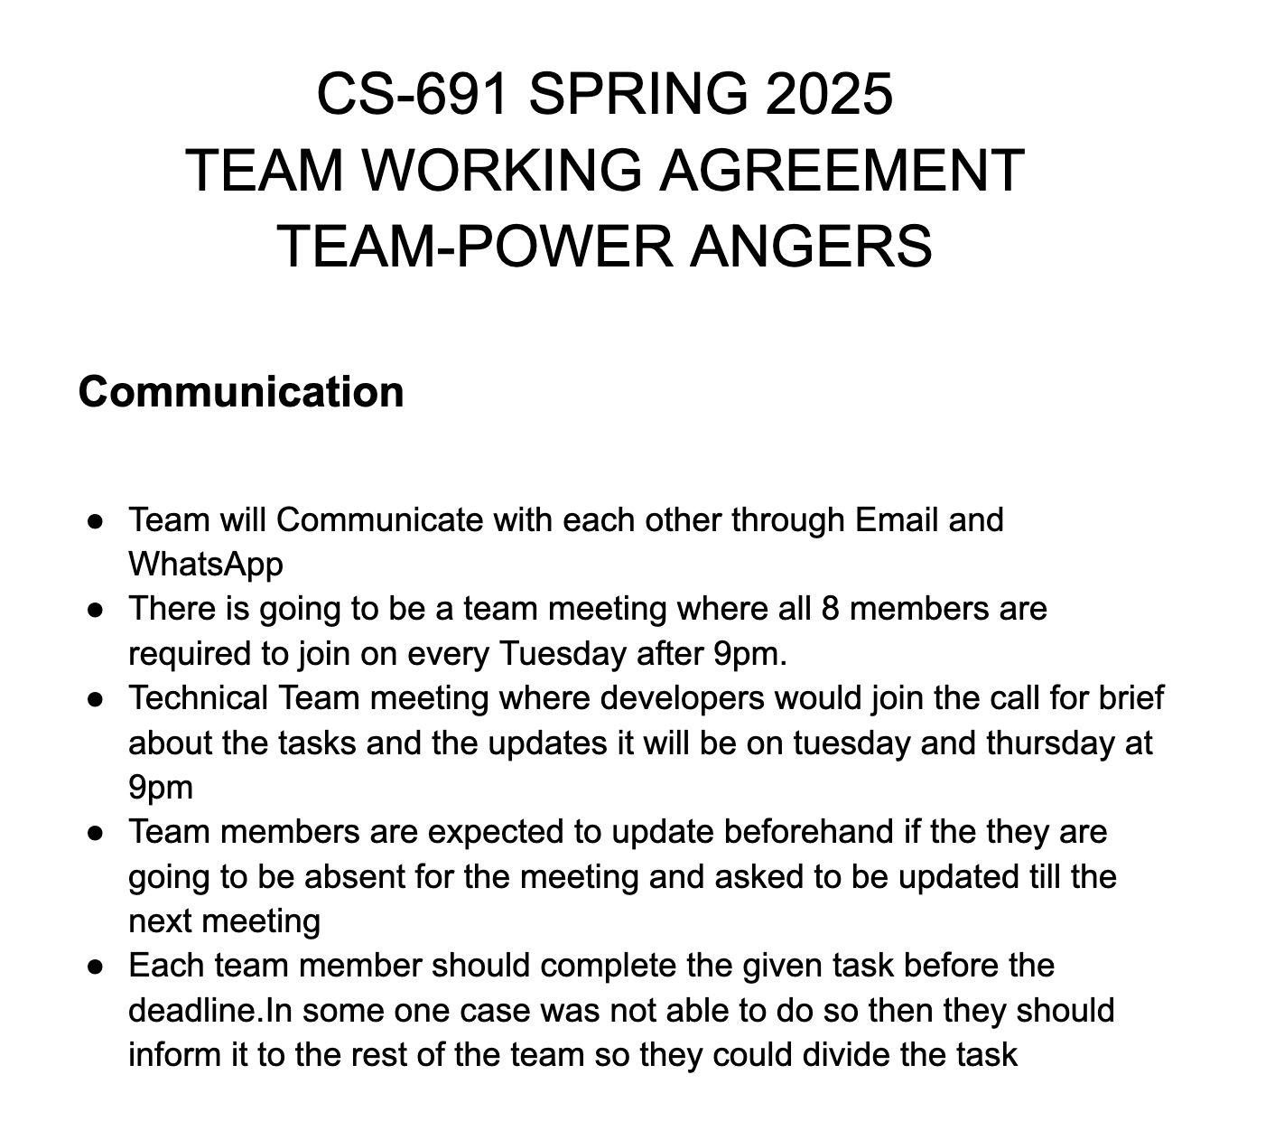
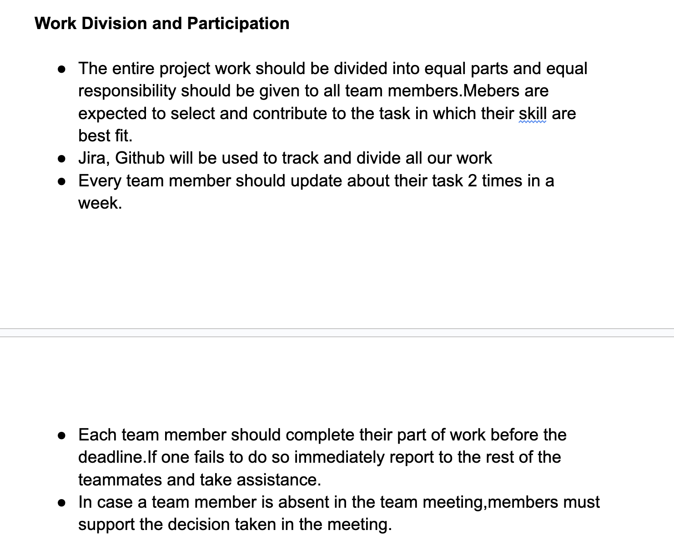
Team Working Agreement

Slide 16
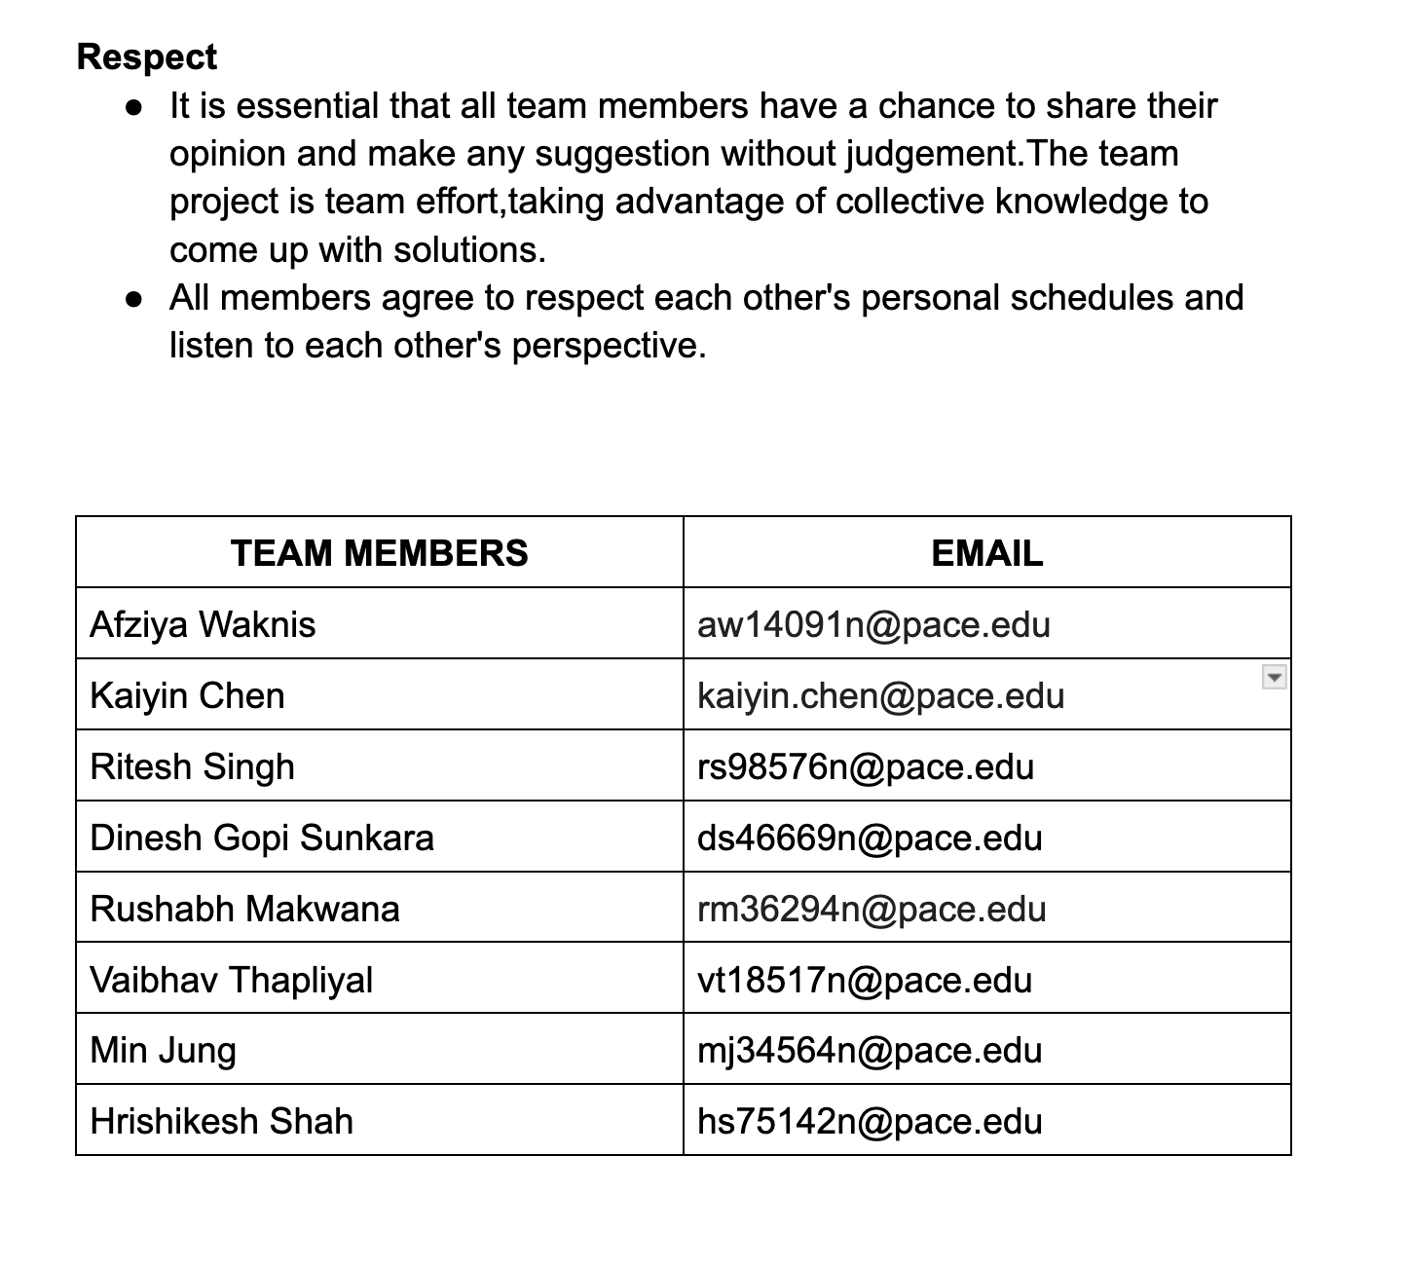
Team Working Agreement

Slide 17
Retrospective
What went well?
What need to improve
Action Items
Everyone was active on Whatsapp
Everyone collaborated in coming up with project ideas
Respected each other's opinions
Team coordination was good
Calls frequency and participation
Need to document what everyone is doing
Everyone needs to speak during the meeting.
Schedule a zoom call and add it in our calender
Setup Jira for Project management.
Start early for sprint 1

Slide 18
https://github.com/htmw/2025S-Power-Anger/wiki
Project Wikipage Link

